Slide 1
Retail Digital Supply Chain
Information Fulfillment Matrix
Santiago Gallino, Charles W. Evans Distinguished Faculty Scholar and Assistant Professor of Operations, Information and Decisions

Slide 2
Review
Today, the digital supply chain is the underlying structure that helps retailers run successfully
Analytics is one of the foundational capabilities that any retailer needs to successfully engage with the digital world
Platforms are relevant players across markets and retail categories

Slide 3
In this Module
Drivers that make a retailer successful
The role of the customer
Customer driven decisions are the ones that will help retailers stay relevant and profitable

Slide 4
Information Fulfillment Matrix
Fulfillment
Offline
Online
Online
Research Online,
Pick-up in Store
Pure-Players
Information Delivered
Offline
Traditional
Retail
Showrooms

Slide 5
Retail Digital Supply Chain
What Do Customers Want?
Santiago Gallino, Charles W. Evans Distinguished Faculty Scholar and Assistant Professor of Operations, Information and Decisions

Slide 6




What Do Customers Want?
What do customers want in an omnichannel experience?
Fulfillment
Return
Policy
Price
Information
Retailer’s
Reputation

Slide 7

Measuring Consumer Preferences
Conjoint analysis

Slide 8
What Do Customers Want?
Fast delivery is better than slow delivery
Customers want the flexibility to return products at no extra cost, anytime
Vast amount of information
Free delivery is better than paying extra
Lowest price

Slide 9

What Do Customers Want?

Slide 10
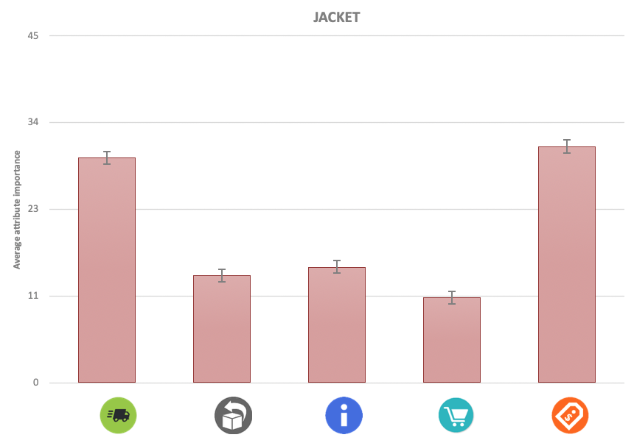
What Do Customers Want?

Slide 11





What Do Customers Want?

Slide 12
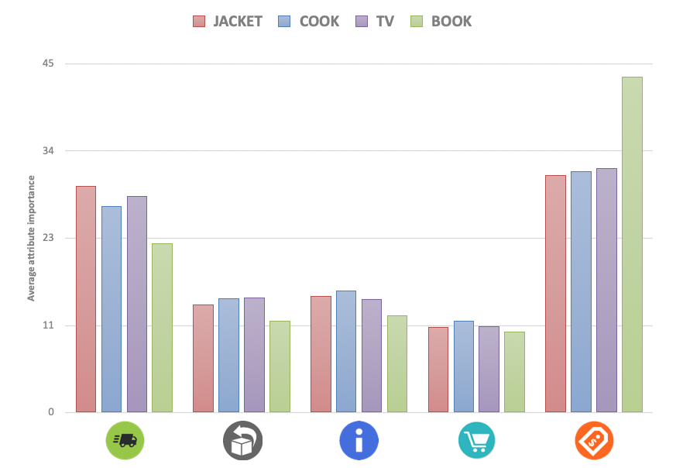
What Do Customers Want?

Slide 13
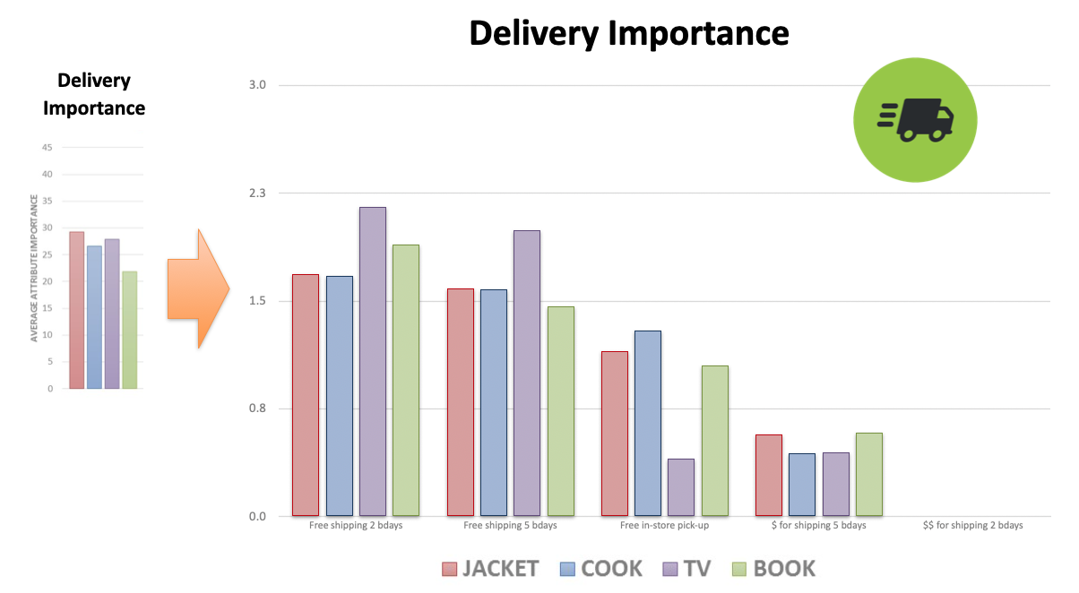
What Do Customers Want?

Slide 14
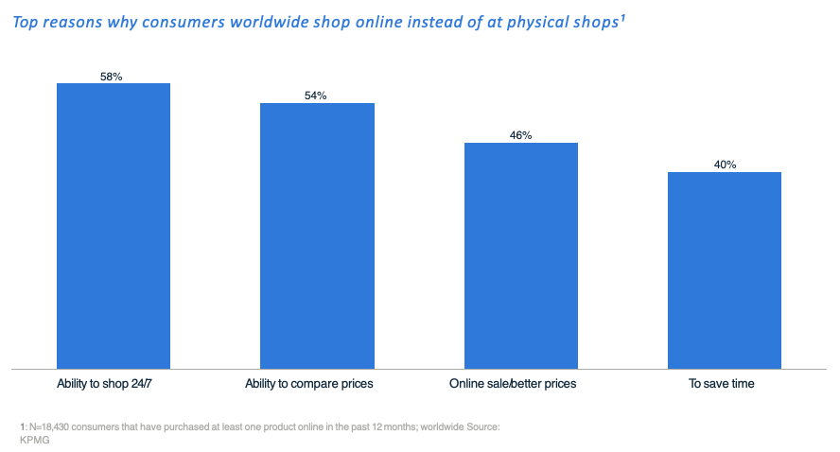
Main Online Advantage: 24/7 Availability

Slide 15
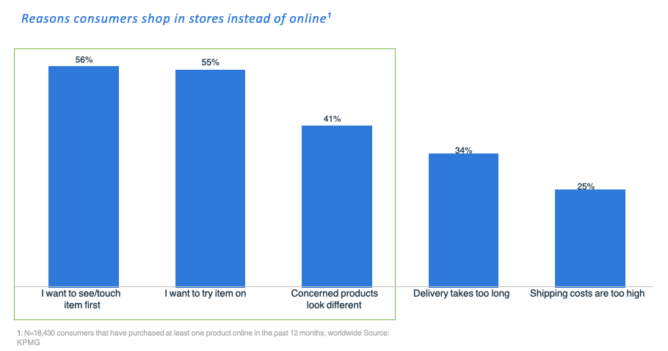
Main In Store Advantage: Ability to See and Try Products

Slide 16

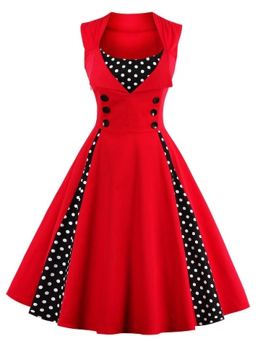



Digital vs. Non-digital Attributes
Digital attributes
Non-digital
attributes

Slide 17
The Problem with Sizing
Relevant sizing
Digital attributes
Non-digital
attributes
Non-relevant sizing

Slide 18
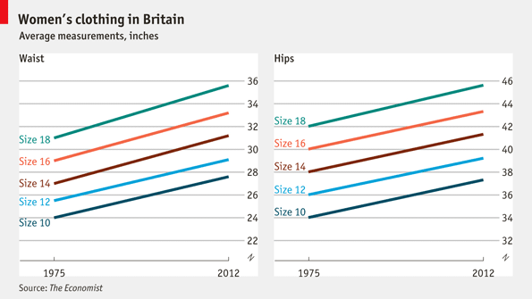
Size Inflation

Slide 19
Retail Digital Supply Chain
What is Best For the Retailer?
Santiago Gallino, Charles W. Evans Distinguished Faculty Scholar and Assistant Professor of Operations, Information and Decisions

Slide 20
Information Fulfillment Matrix
Fulfillment
Offline
Online
Online
Research Online,
Pick-up in Store
Pure-Players
Information Delivered
Offline
Traditional
Retail
Showrooms

Slide 21
Understanding the Digital Intensity
Digital Intensity Market
Low
High
Electronics
in the UK
High
Digital Intensity Category
Low

Slide 22
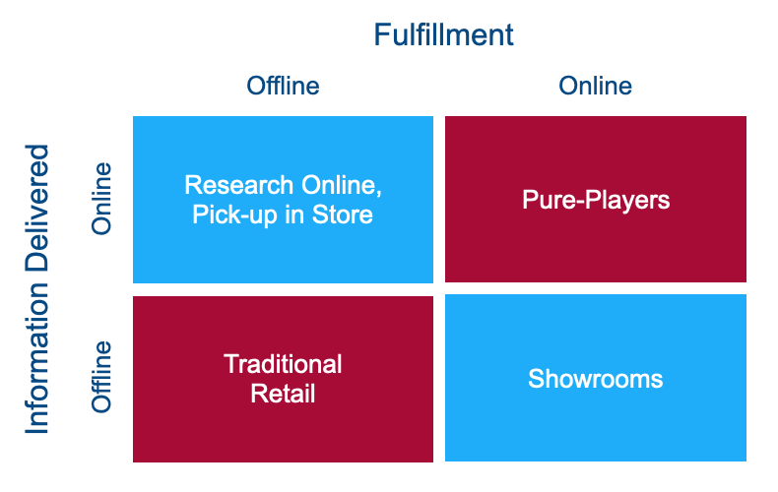
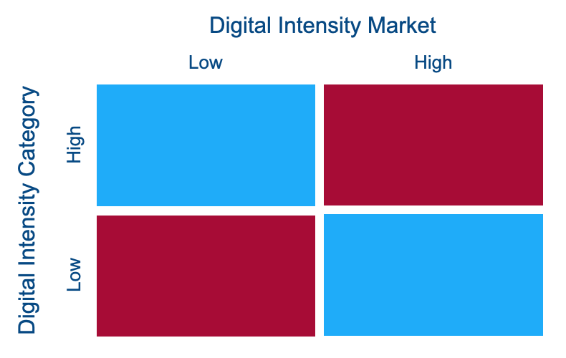
Understanding the Digital Intensity
Electronics
in the UK

Slide 23
Understanding the Digital Intensity
Electronics
in the UK
Apparel in the US

Slide 24
Understanding the Digital Intensity
Electronics
in the UK
Grocery in
South Africa
Apparel in the US

Slide 25
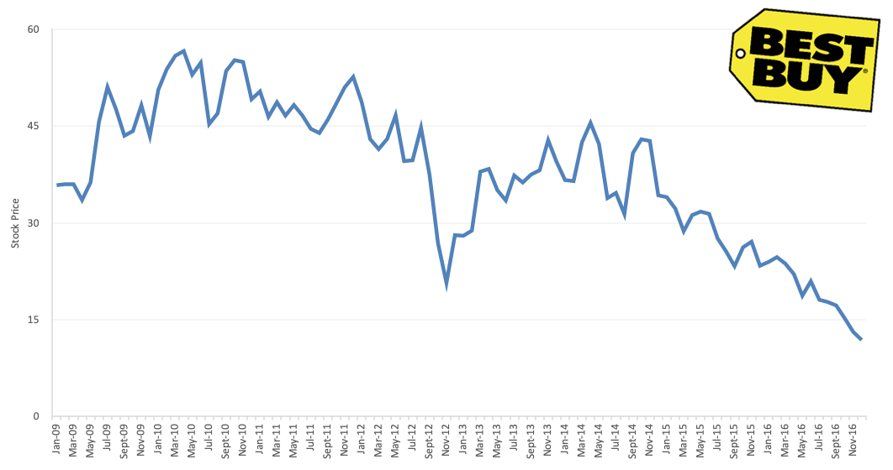
Best Buy

Slide 26
Best Buy
The disruption of the digital transformation in the electronics category in the US had a massive impact on the traditional electronic retail companies
For all practical purposes, Best Buy had become a showroom for e-commerce retailers
Customers were visiting Best Buy stores, interacting with the products, learning from the sales associates, and then going home to buy online from other retailers

Slide 27
Best Buy
Best Buy management saw that the service they were providing was valuable to both customers and manufacturers
But the current business proposition, they were able to capture only a very small fraction of the value they generate
Customers were not paying for that showroom service
Companies selling the products at Best Buy were not paying for the service either

Slide 28
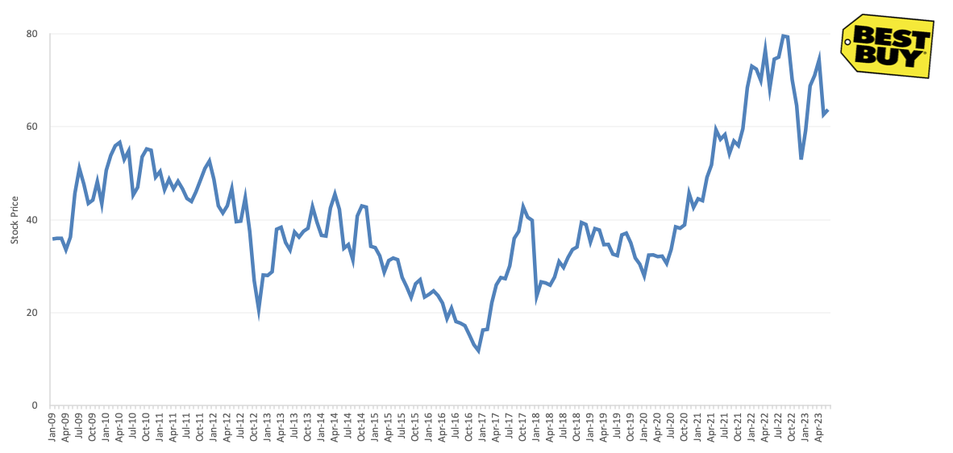
Best Buy

Slide 29
Showroom Concept: Best Buy
Best Buy embraced the showroom concept
Reached out to brands that were selling their products online and showed them the value that Best Buy was providing as a prime showroom location
Redesigned the stores to embrace the showroom activity of customers
Invited manufacturers to have branded stands where they could showcase their products to the customers

Slide 30
How to Capture Value: Best Buy
Best Buy reached out to the brands and explained the value they were providing, and that this value could not be easily replicated if Best Buy went out of business
Once this message was understood by the brands, convincing them to pay for that service came as the next natural step
By embracing the customers showrooming activities, Best Buy was able to survive and thrive again

Slide 31
Retail Digital Supply Chain
The Value of Employees and the Supercharging Effect
Santiago Gallino, Charles W. Evans Distinguished Faculty Scholar and Assistant Professor of Operations, Information and Decisions

Slide 32
The Value of Employees
The role and tasks that employees will need to do must change and adapt
There are a number of tasks that were traditionally performed by employees in physical stores, that in digital stores are no longer relevant
In some cases, those tasks can be completed by implementing an algorithm or by buying a piece of technology
There are other tasks, old and new, where an engaged, well trained employee can not be replaced

Slide 33
Impact of Online Learning
For each training module that an employee was taking to learn more about the products they were offering
Increase of 1.8% in monthly sales

Slide 34
Training Benefits
Online training is a fantastic tool that can be scaled in a cost-effective fashion
Training on different product features
Training on how to perform a task, such as restocking or processing customer returns
Training in how the company is planning to transform and adapt to the digital world

Slide 35



Supercharging Effect
Relationship Level
Interaction

Slide 36
Supercharging Effect at Showrooms
Supercharging effect also happens when a customer transitions from an online transaction to contacting the retailer through the call center and ultimately visiting a physical store and interacting with the physical space and the sales associates

Slide 37
Supercharging Effect at Showrooms
Benefits of physical contact between the customer and the retailer
The supercharged customers were buying more products, across more categories, and with higher prices
Returns, even those later bought online, also went down

Slide 38
Supercharging Effect at Showrooms
The supercharging is successful when the physical presence of the retailer is carefully thought out and the employees that interact with the customers are well trained
In the same way we can have a positive supercharging experience, we can have a negative supercharging experience
The retailer needs to make sure that the employees know what they are supposed to do when they meet the customer, and that the overall store execution is done well

Slide 39

Supercharging Effect

Slide 40
Retail Digital Supply Chain
Digital Transformation of the Supply Chain
Santiago Gallino, Charles W. Evans Distinguished Faculty Scholar and Assistant Professor of Operations, Information and Decisions

Slide 41
Digital Transformation of the Supply Chain
Where to start with the digital transformation of the supply chain?
Make a list of all the cutting edge technologies that are available today
Rank them based on how disruptive these can be to your business

Slide 42
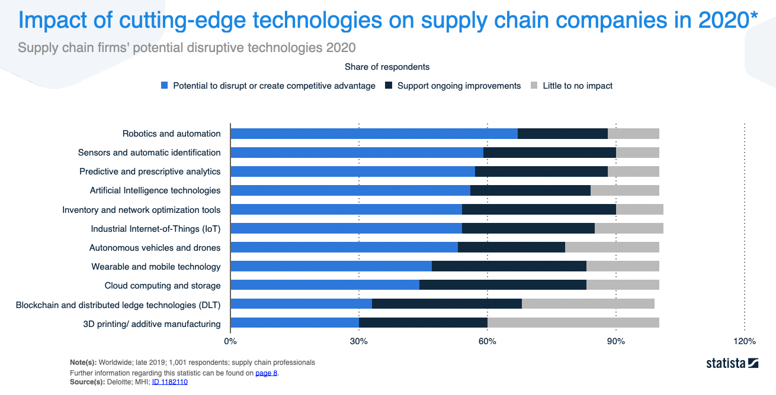
Technologies and Their Potential to Disrupt

Slide 43
Technologies and Their Potential to Disrupt

Slide 44
Technologies and Their Potential to Disrupt

Slide 45
Technologies and Their Potential to Disrupt

Slide 46
Technologies and Their Potential to Disrupt

Slide 47
Technologies and Their Potential to Disrupt

Slide 48
Technologies and Their Potential to Disrupt

Slide 49
Digital Transformation of the Supply Chain
Where to start with the digital transformation of the supply chain?
Make a list of all the cutting edge technologies that are available today
Rank them based on how disruptive these can be to your business
Make a list of the technologies that your company is adopting today, or is planning to adopt in 1-2 years

Slide 50
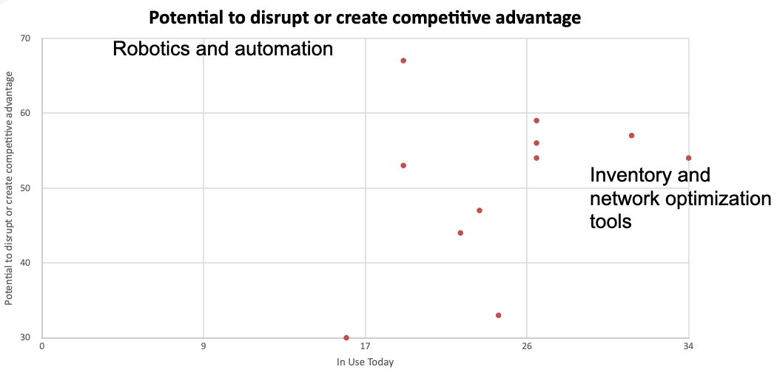
Evaluating Fit

Slide 51
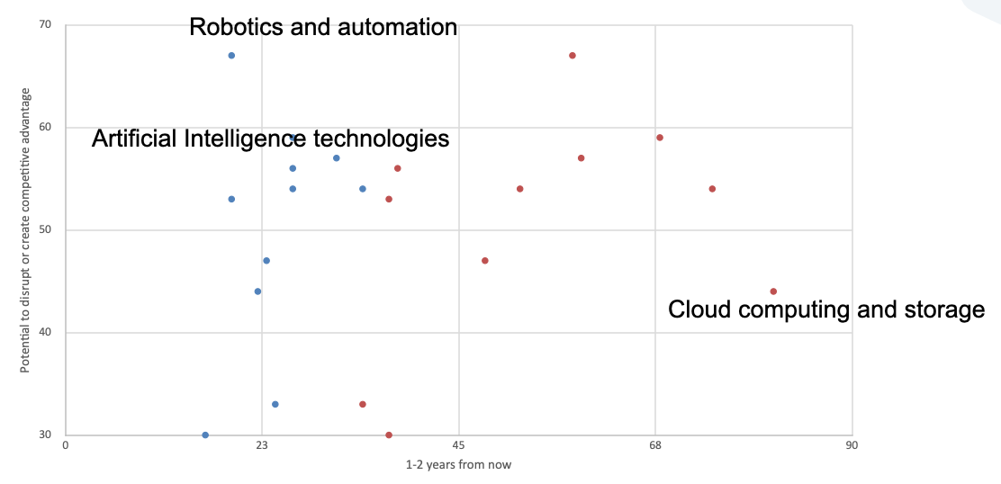
Evaluating Fit

Slide 52
Course Conclusion
The digital disruption has arrived to every part of the supply chain
The coordination and rationalization of the different flows (products, payments, and information) in the supply network is essential to the retailer today
These flows today are not happening in a linear fashion
The supply chain has evolved to become a sophisticated network

Slide 53


